Slide 2


Slide 3

Pandiyan Murugan
Microsoft MVP Principal Software Engineer @ lightcast.io

Slide 4
Building SaaS application on Azure
Pandiyan Murugan

Slide 5
What is the most difficult thing to build?
SaaS?
PaaS?
IaaS?

Slide 6

Building attention after good lunch :)

Slide 7
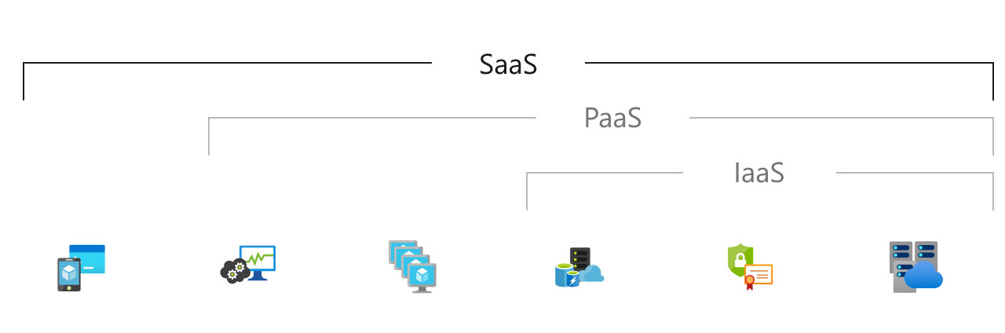
What is SaaS?
Software as a service (SaaS) allows users to connect to and use cloud-based apps over the Internet. Common examples are email, calendaring, and office tools (such as Microsoft Office 365).
SaaS provides a complete software solution that you purchase on a pay-as-you-go basis from a cloud service provider. You rent the use of an app for your organization, and your users connect to it over the Internet, usually with a web browser.

Slide 8
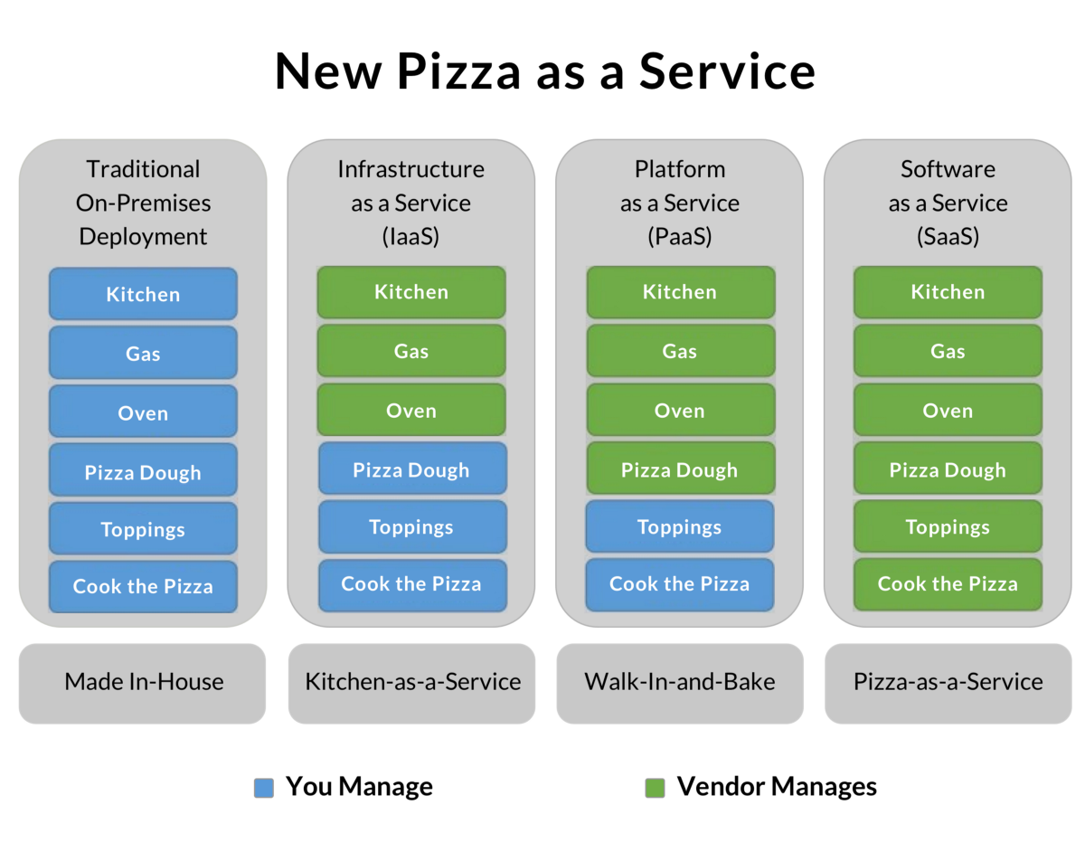

Slide 9
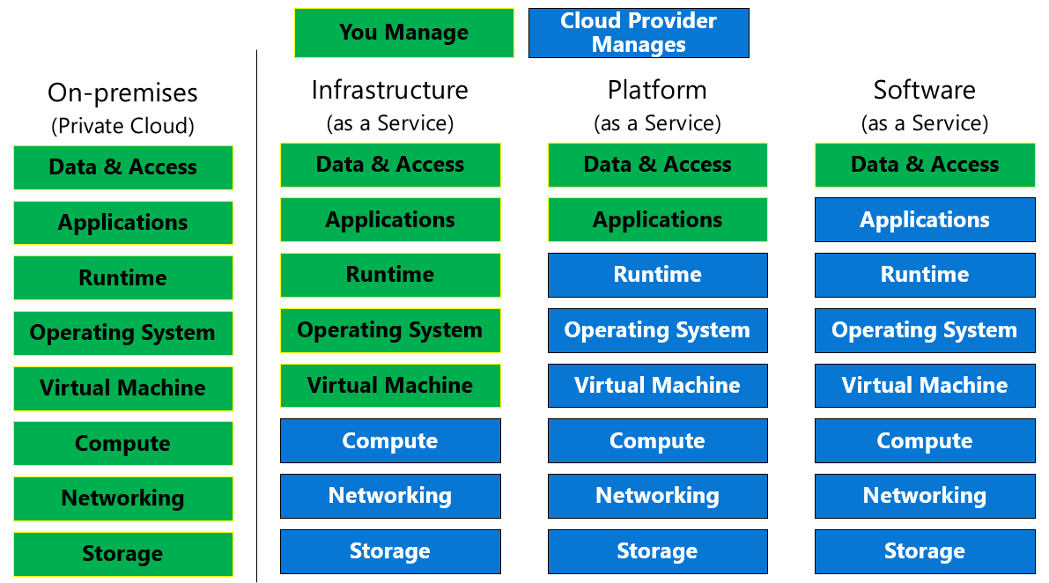

Slide 10


Slide 11
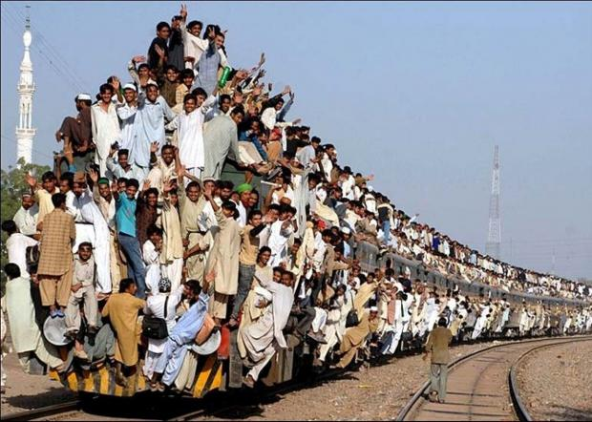

Slide 12
What I have tried to build?
A train schedule search app, which uses
Azure AD - Active Directory - Sign in users
Static Web Apps - To host web app
Azure function - Provides data over http request
API - CRUD operation of data manage
GitHub - Version control
Azure pipelines - Seamless deployment
And everything is on azure environment ❤️

Slide 13
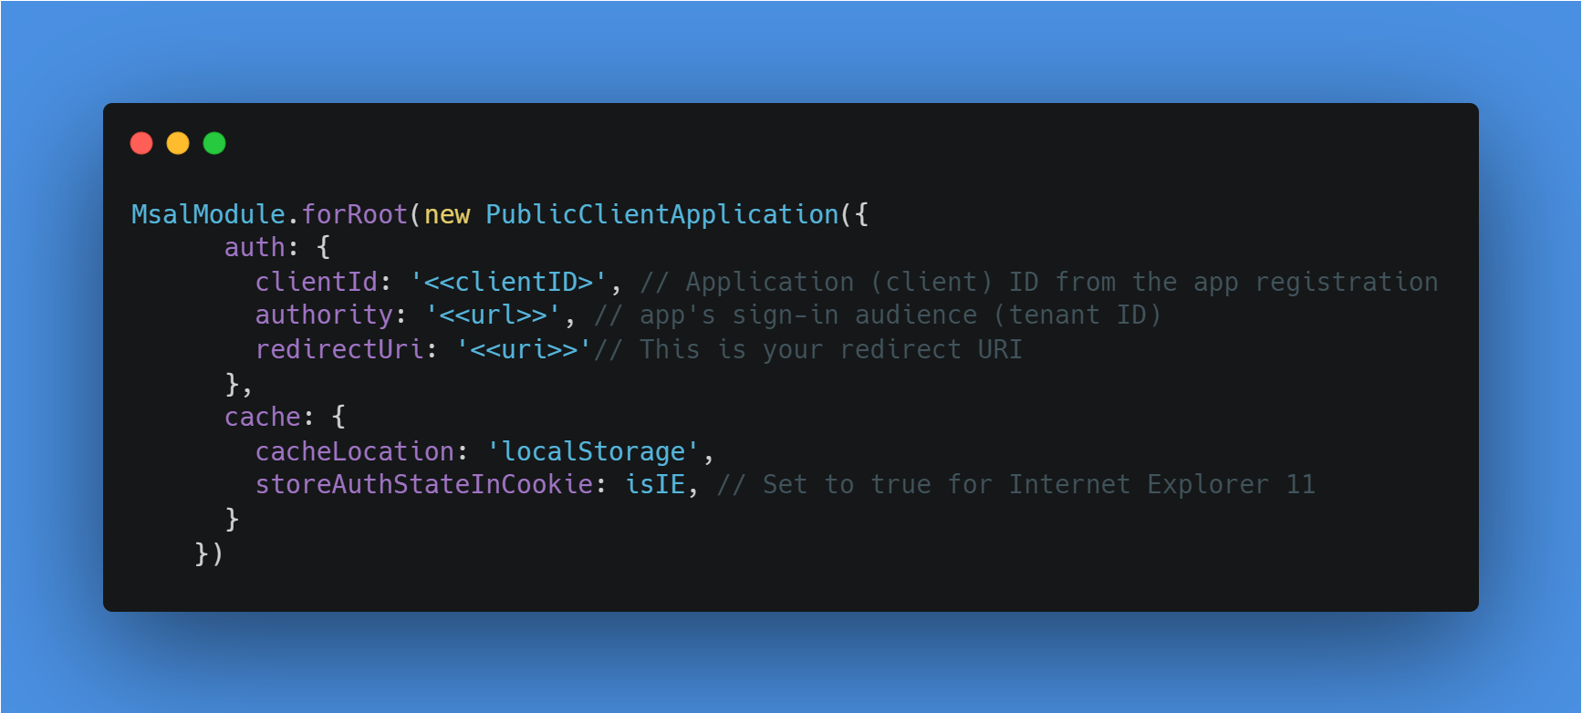
Azure AD in angular
npm install @azure/msal-browser @azure/msal-angular
Add the authentication components
Add app registrations
Add redirect uri
Add token in client side

Slide 14
Small and interesting SaaS apps
Calenders
csv to json
Image crop
etc

Slide 15






Platinum Partner
Gold Partner
Silver Partner

Slide 17
THANK YOU!
Building Saas Application on Azure
Pandiyan Murugan
@pandiyan_cool
efficientuser.com
github.com/pandiyancool

